Slide 1
WA Verify+: Empowering Patients To Share Immunizations & Other Data
AIRA 2025 National Meeting

Slide 2

AIRA 2025 National Meeting Presenter
Chris Baumgartner
Deputy Chief Informatics Officer
Washington State Department of Health

Slide 3

Where We Have Been

Slide 4
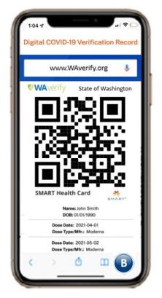
Background
Digital vaccine verification in Washington State using SMART Health Cards​
Successful Public-Private-Academic partnership​
Leveraged the shareable components and reusable code​
Rapid 8-week development, deployment, and testing​
Currently available in 52 languages​
Nearly 2 million verification requests since launch (October 2021)​
Demoed printed cards at HIMSS23 Interoperability Showcase​

Slide 5

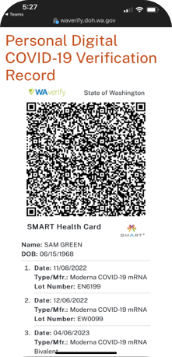
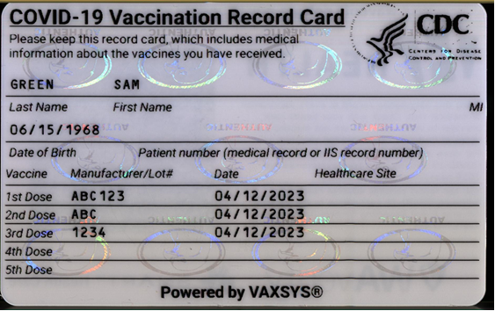
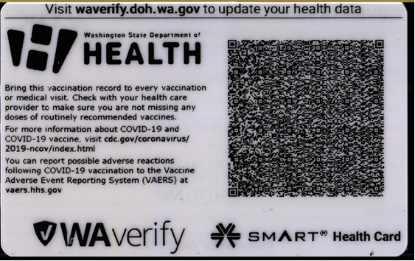
SMART Health Card QR Code and Printed Card
Users can save their QR codes to Health or Wallet app, or as a PDF to file

Slide 6
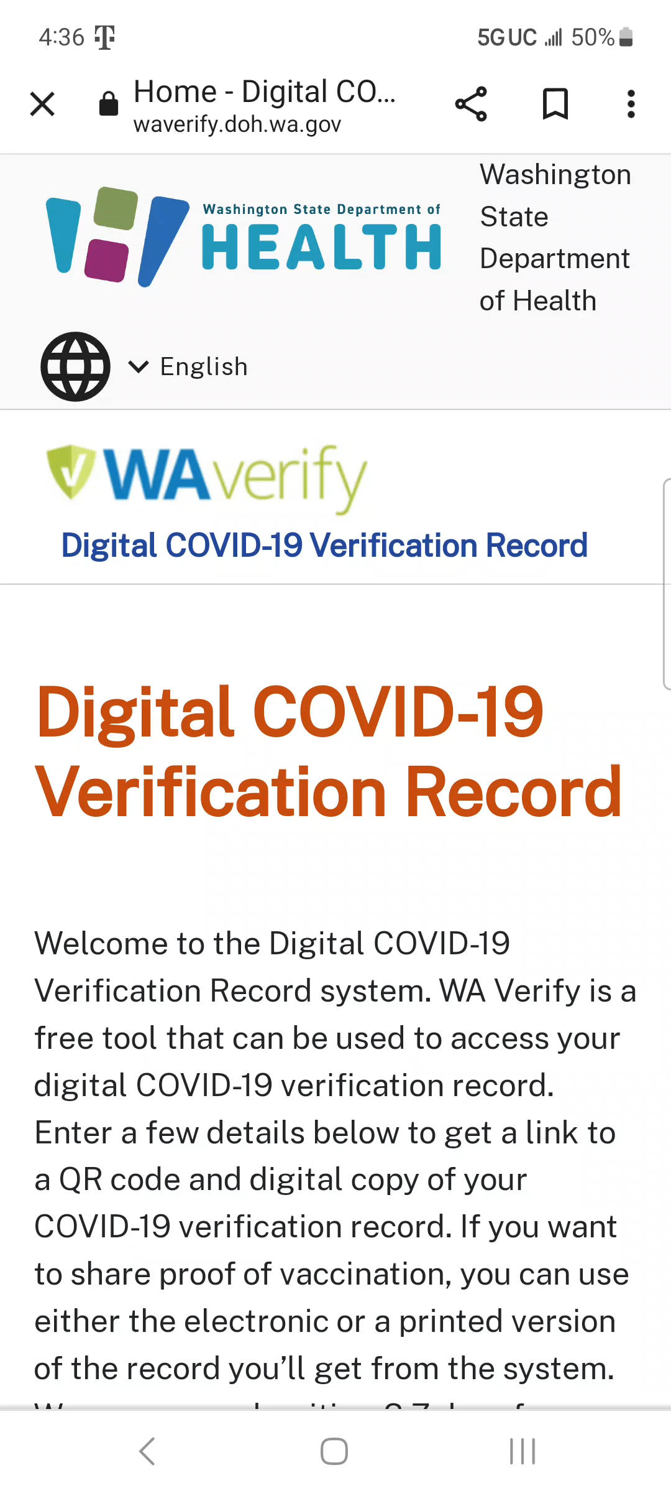
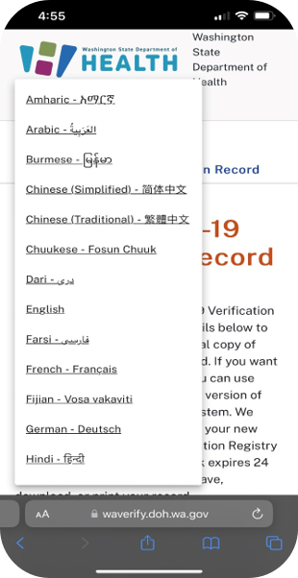
Multi-Language Accessibility
Language is selected or auto-translates to the language pre-selected within system or browser settings.
WA Verify’s 52 supported languages represents the most of any Verifiable Clinical Information (VCI) issuer.

Slide 7
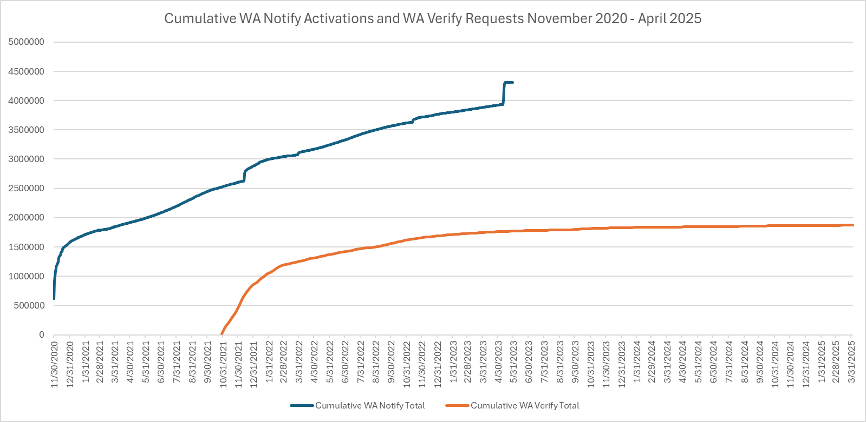
Cumulative WA Verify Requests and WA Notify Activations
Notes:
Last updated 9/18/24

Slide 8
WA Verify Evaluation
Methods
UW administered two surveys: (1) a statewide survey capturing knowledge, attitudes, and practices of Washington residents around public health technologies and (2) a follow-up survey on public opinion and concerns about public health technology and expanded use cases.
Results/Findings
The survey results revealed a strong sense of trust and confidence in public health and its technologies. Respondents ranked several WA Verify+ tool expansions as “high” and “medium” priorities, including expansions providing access to immunization records, advanced directives, and medical records .

Slide 9
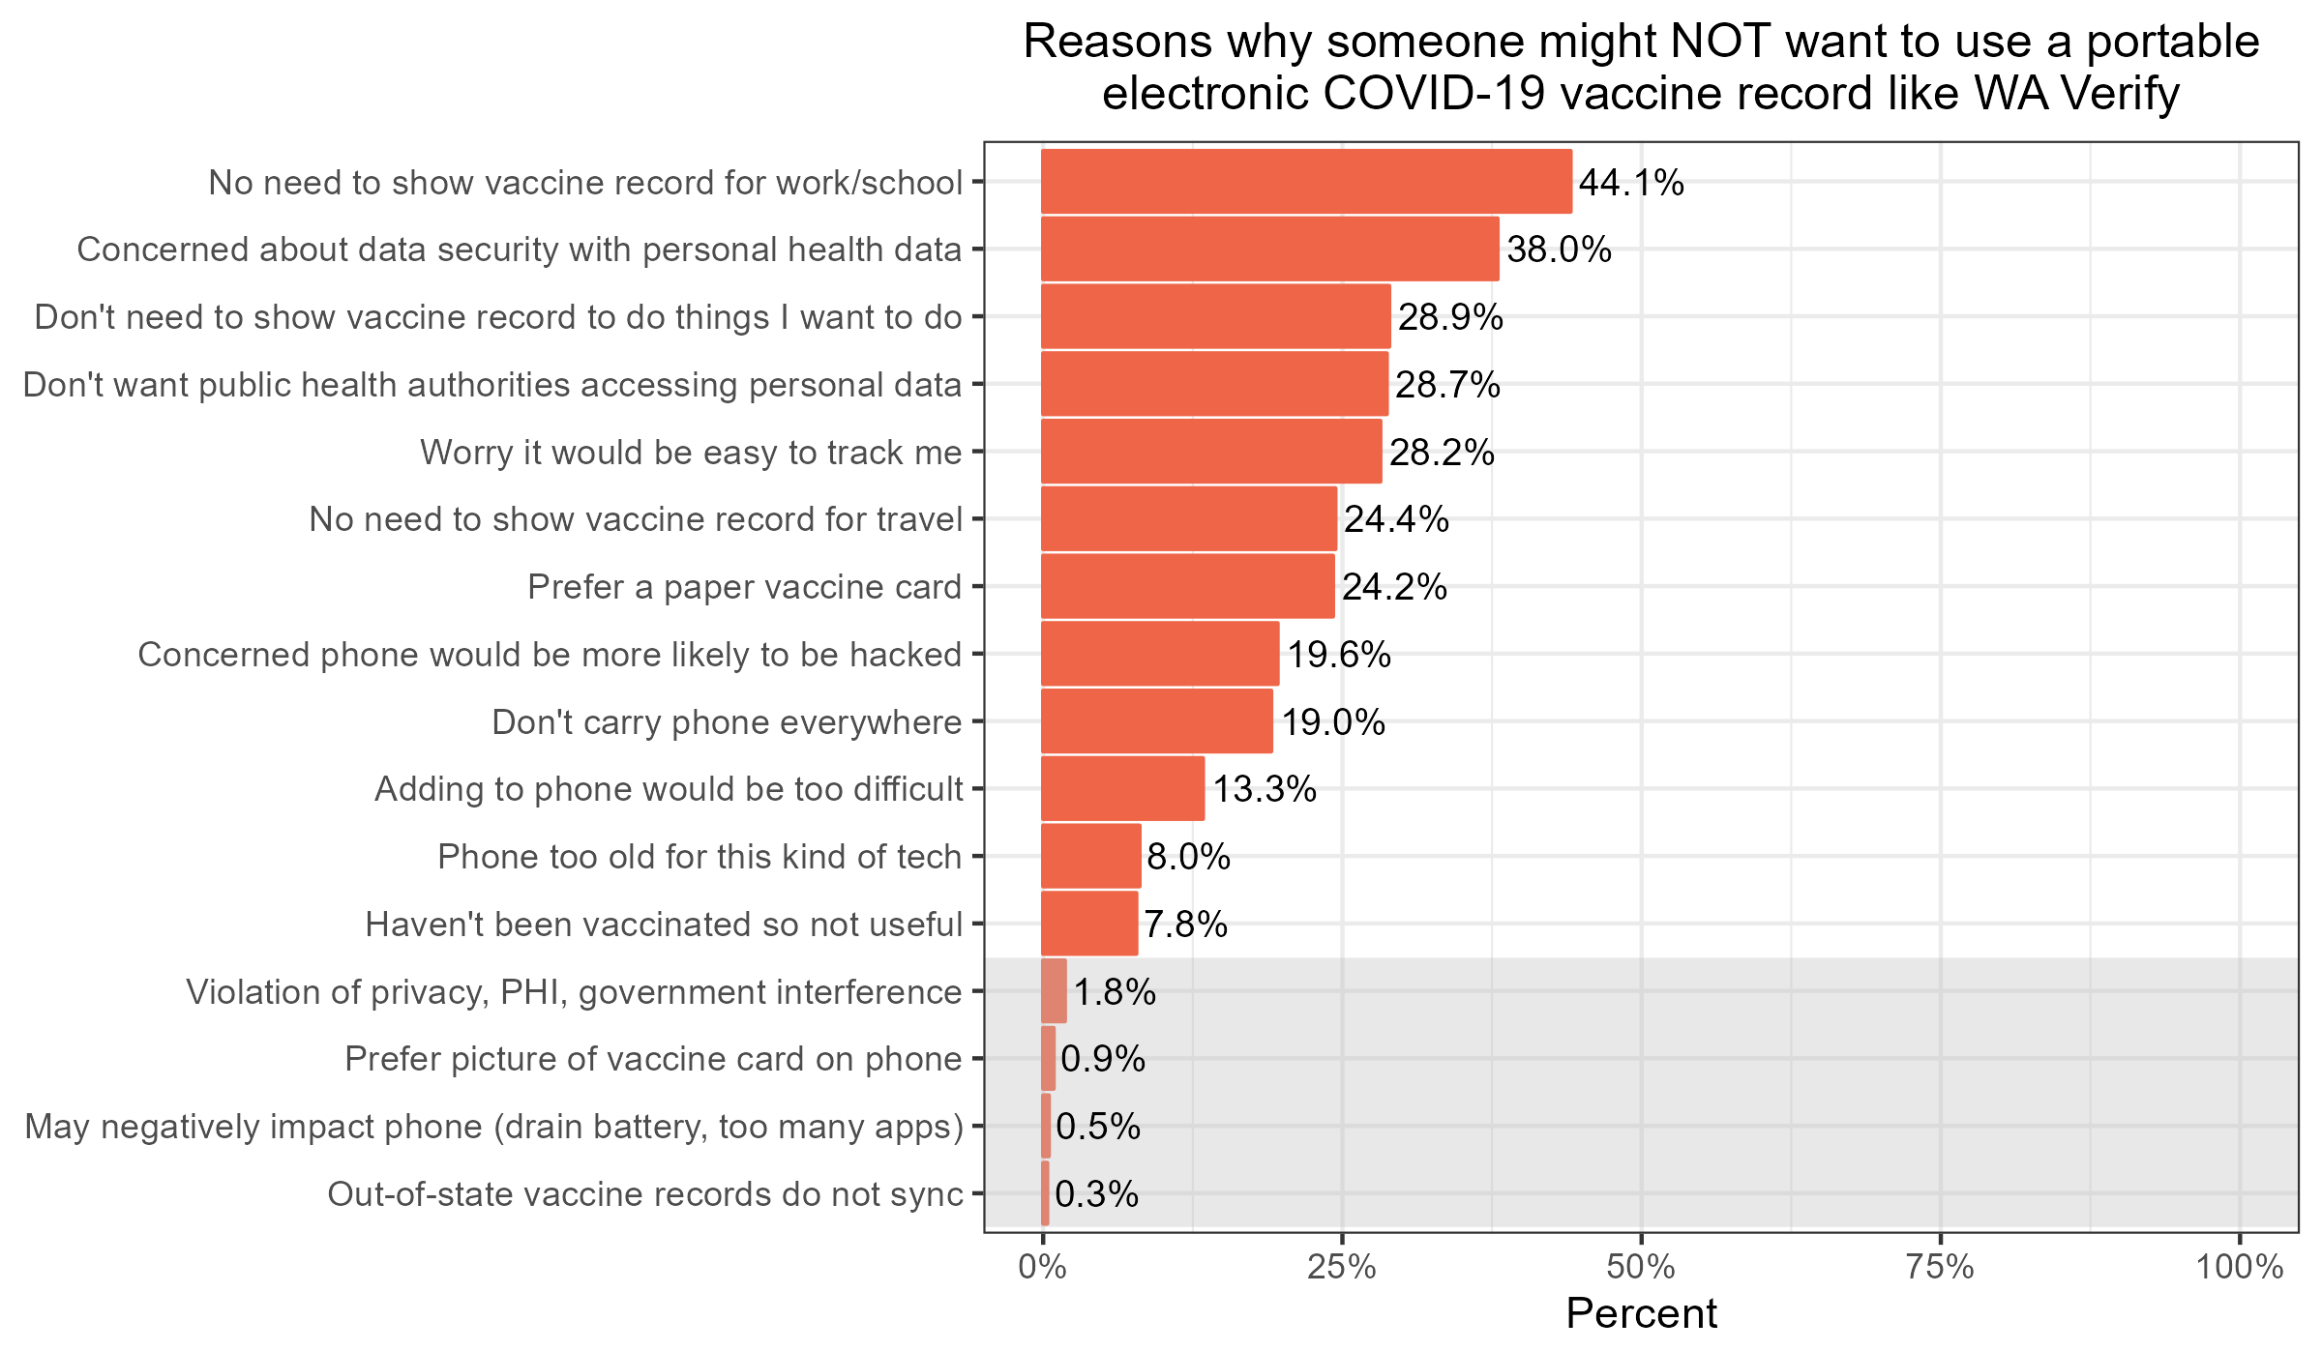

Slide 10
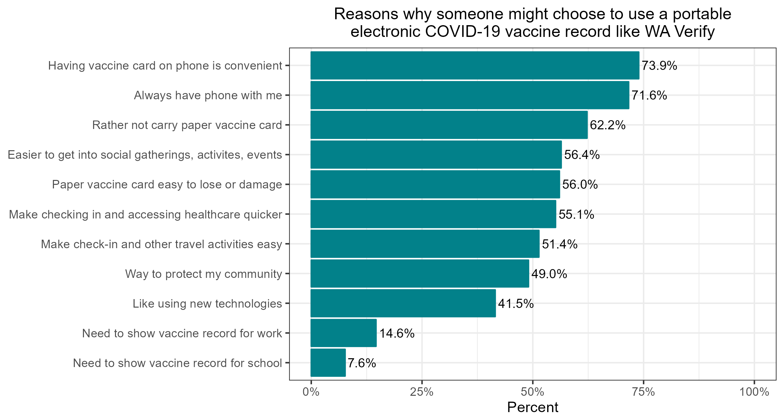

Slide 11
Survey Respondent Priorities for WA Verify+ Expansion
Notes:
As a part of the WA Verify Evaluation Project, we conducted an online survey of (138?) WA Residents and pilot focus groups to learn about priorities and opinions related to the expanded uses of Smart Health Cards and Smart Health Links technology.
We asked respondents to provide a priority level to indicate the importance and priority of each of six use cases for WA Verify or similar technology.
More respondents selected High or Medium priority for access to medical records while traveling (IPS) than any of the other options. There seemed to be more confusion (more “not sure” answers for “A tool to display COVID-19 immunization status” possibly due to the fact that this tool already exists.

Slide 12

Where We Are Going
Notes:
Conclusions
Our state has already seen the benefits of the WA Verify app in use, providing individuals with secure, portable, digital access to their COVID-19 vaccine records as a SMART Health QR Code. With a clearer picture of individual and agency needs, WA DOH has been developing the expanded WA Verify prototype, in collaboration with the UW Clinical Informatics Research Group (UW CIRG). This tool can assist Washingtonians with important use cases such as international travel, registering children for school, and updating new providers of a full immunization history. We are excited about how this initiative leverages modernization tools such as FHIR standards and leveraging TEFCA.

Slide 13

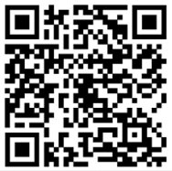
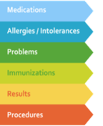
Smart Health Links
Utilizing the International Patient Summary (IPS)Standard​
Patient directed key verifiable clinical data for travel​
Embedded URL in a QR code that links to data and/or FHIR endpoints​
Patient Summary Demo Link

Slide 14

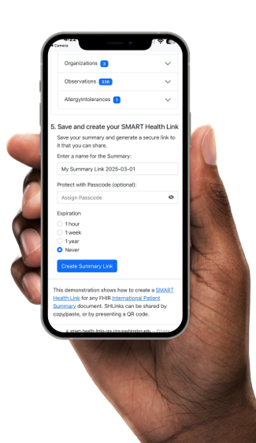
Patient Controlled
Expiration duration – 1hr, 1 week, 1 year, never
Verifiable & Secure
SMART Health Link can be passcode protected
Manage Dependent Records
Data from dependents/children accessible under the same Link/QR Code

Slide 15
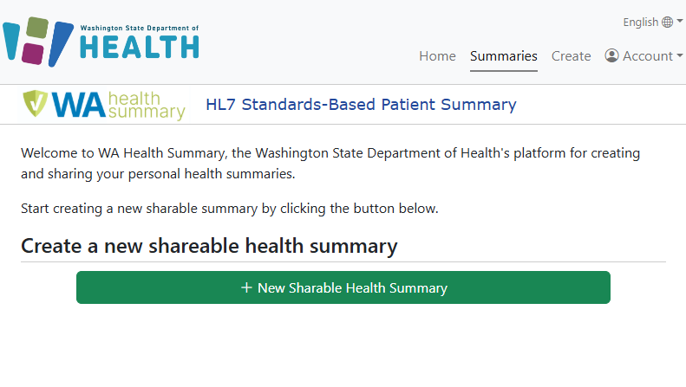
Multiple Methods for Access & Storing
SMART Authorization​​
Epic​​
Oracle/Cerner​​
MEDITECH​​
eClinicalWorks*
FHIR URL​​
FHIR Bundle​​
TEFCA Query
Notes:
*Tested but not live

Slide 16
Full Immunizations +
Benefits For Users
Benefits For Providers
Benefits For Public Health
School enrollment
Verification for international travel
Foreign and domestic healthcare emergencies
Patient controlled and empowered to take active role in healthcare management
Timely access to patient history
Reduce medical data entry redundancy
Reduce administrative burden and waiting periods in record requests
Shareable across different settings (ie. PCP, Specialists, Urgent Care, Pharmacies)
Seamless transition of care
Real-time surveillance of vaccine coverage
Aggregate data for targeted interventions and campaigns
Prevent accidental duplicate vaccinations
Seamless Data Sharing, Reduce Errors and Burdens, Improved Care and Intervention
Notes:
Seamless Data Sharing

Slide 17
International Vaccine Codes (IVC) Initiative
Create global network of vaccine code experts
Advocate for vaccine codes
Not replacing current code sets
Provide professional development
Peer group for code experts
Bordeaux Summit – May 9
Join global experts to advance interoperability and the coding of vaccinations
Participate in key discussions on NUVA, global standards, and best practices

Slide 18

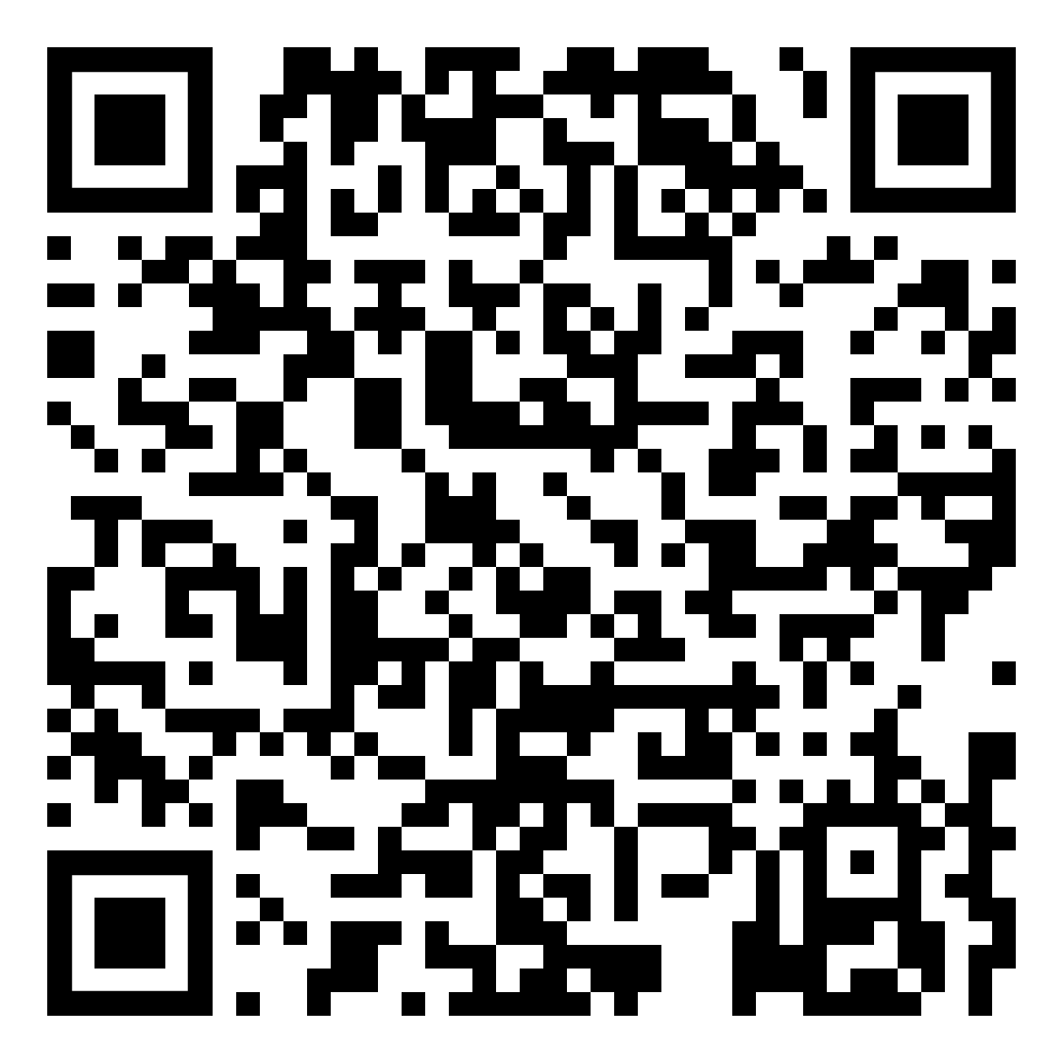
Bordeaux Summit Register for Online Access
Event: International Summit on Vaccine Coding & Standards Place: Radisson Blu Hotel, Bordeaux, France Date: May 9, 2025 Time: 9:00 am to 5:00 pm Central European Time
Morning Session
3:00 am – 6:15 am U.S. ET
IVC and NUVA
SNOMED-CT opportunities
Manufacturer viewpoints
Global perspectives
EU cross-border records
WHO Drug
Afternoon Session 7:15 am – 11:00 am U.S. ET
Experiences from Luxembourg, Latin American, U.S., Canada
Europe Electronic Vaccine Card
Mapping vaccine codes, quality, and code metrics
Long term goals and what’s next

Slide 19
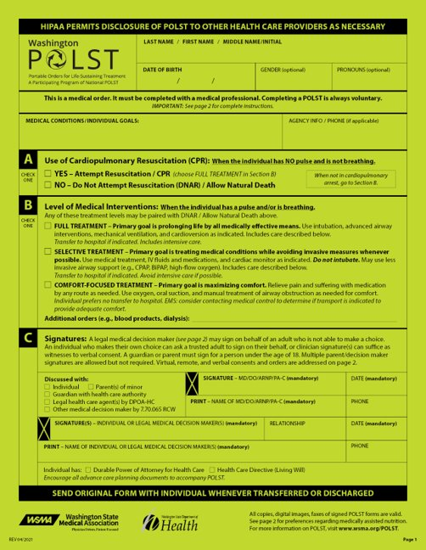


Portable Orders for Life Sustaining Treatments​
Moving from paper forms to digital portable wishes​
POLST​
Advanced Directives​
MHAD​
Power of Attorney​
Participating in HL7 standards development​

Slide 20












Public-Private-Academic Partnerships
Public-Private-Academic coalitions have a unique power to do what a single entity cannot by itself. This superpower is invaluable when interoperability is needed and the common good is at stake.

Slide 21
Tabletop Discussion – Starts at 11:15 AM
How can use of USCDI and SMART Health Links benefit lifelong immunization history and other data types?
What are the opportunities and challenges of this tool with regards to interoperability and optimal patient care during international travel?
What ideas do you have on how immunization data could be leveraged for other use cases by engaging professionals in the Immunization Information Systems community?

Slide 22

Questions?

Slide 23
To request this document in another format, call 1-800-525-0127. Deaf or hard of
hearing customers, please call 711 (Washington Relay) or email doh.information@doh.wa.gov.

